Slide 1
Forecasting industrial water demand due to Climate change scenarios

Slide 2
Data Sources
Thüringer Landesamt für Statistik
Non Public water supply statistics (2004 – 2019)
Gross Value added (2004 – 2019)
SSP Database (Shared Socioeconomic Pathways) - Version 2.0
DWD weather climate extremes
Other related literature sources
Notes:
check backup slide for the full one

Slide 3
Conceptual Framework
Industrial Water Demand model (Kreis-level)
DWD Weather Data
Climate Elasticity (CE)
TLS Statistics
Calibration
Gross Value added (GVA) at Kreis Level
Industrial water withdrawals at Kreis Level
Technological Change (TC)
Simulated industrial water withdrawals
RCP climate Scenarios
Scenarios
Projected industrial water witthdrawals
SSP Scenarios

Slide 4
Methodology (upto now)
Collection of historical data on;
Industrial Water Withdrawals (IWW): From industrial and water resource databases (TLS).
Gross Value Added (GVA): Representing industrial economic activity.
Climate extremes: Including historical climate data and projected temperature under selected SSP/RCP scenarios.
Technological Change: Use data on industry-specific water-saving technologies or estimates based on technological trends.
Specify a multiple regression model to assess the direct effects of GVA and temperature, moderated by technological change, on IWW.
Run the model under selected SSP/RCP scenarios to forecast future IWW, analyzing outcomes for different climate and economic assumptions.
Projection model:
IWW​=β0​+β1​⋅GVA+β2​⋅T+β4​⋅TC+ϵ

Slide 5
Methodology and steps involved in calculating Technological change factor (TC)
Calculated the technological change factor in different ways
1. Calculating the TC using the "andbet" which is how much ind wastewater was recycled by company's own treatment plant. But this had no significant relationship with water withdrawals
2. Calculated TC as a proxy of water intensity (water withdrawals per unit of GVA) and this also didn’t have a significant relationship with water withdrawals
3. Calculated TC using the growth of circular water use as a proxy.
A simple growth function was used to find the growth rate of circular water use over time and used that value as a factor of TC
Linear growth function: circular_use = β₀​+β_{l}​(year)+ϵ
β_{l}​: 507.6
Since the aggregated circular water use from 2004 – 2019 follows a strong linear trend, we assume the best proxy for TC is the linear growth trend which is 507.6 units per year.

Slide 6
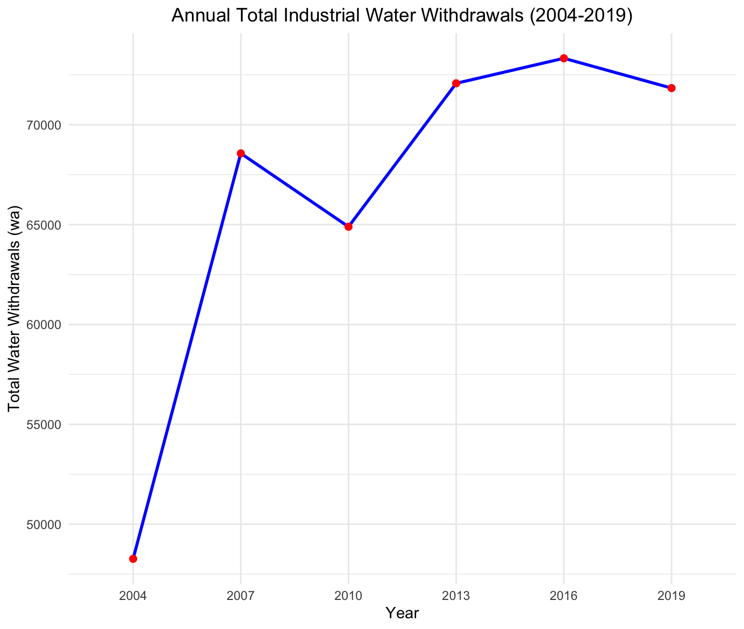
Results – Trends in Water withdrawals (State level)
Water withdrawals increase over time until 2016 and then starts to decline afterwards.
The peak consumption was recorded in 2016 which is 72075000 m³

Slide 7
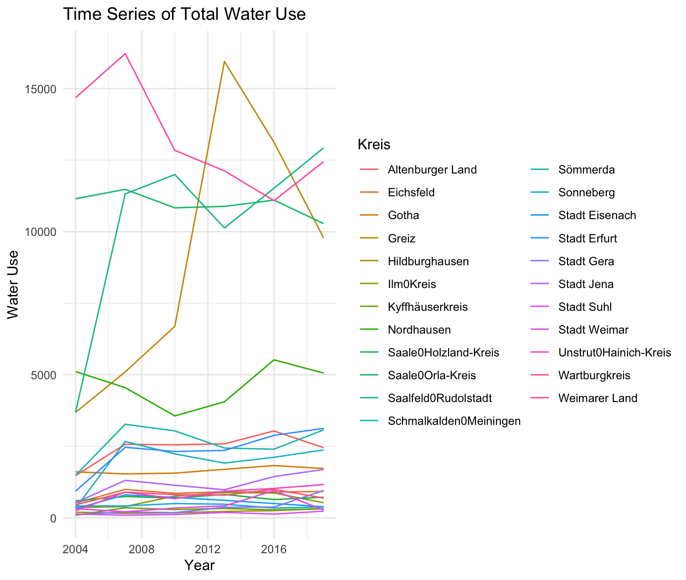
Results – Trends in Water withdrawals (Kreis level)
Notable increase of water withdrawals in Greis and Saale-orlakreis is observed overtime.
The withdrawals in Wartburgkreis dropped over time.
Water withdrawals in other Kreis stayed somewhat constant over the time

Slide 8
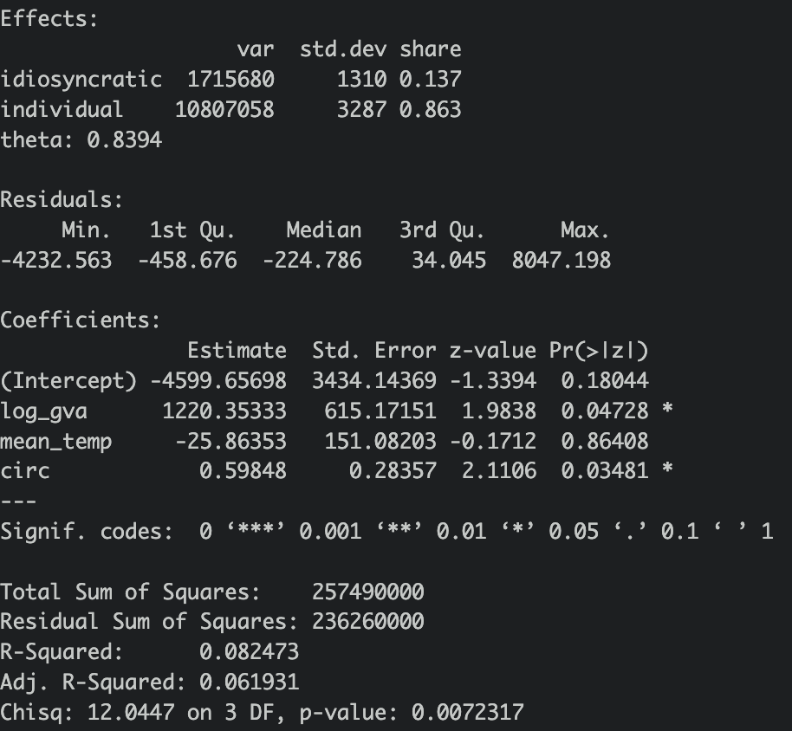
Results – Regression analysis of the IWW model
Regression model
IWW​=β0​+β1​⋅GVA+β2​⋅T+ β3Circular + β4​⋅TC+ϵ
Results
For a unit increase of log_gva , water withdrawals increases by 1220.353 and is statistically significant.
For a unit increase of circular water use, water withdrawals increased by 0.59848 and is statistically significant
The changes in other variables were not statistically significant.
The model is statistically significant overall (P.val 0.007), but predictors explain only about 8.25% of the variance in water withdrawals.

Slide 9
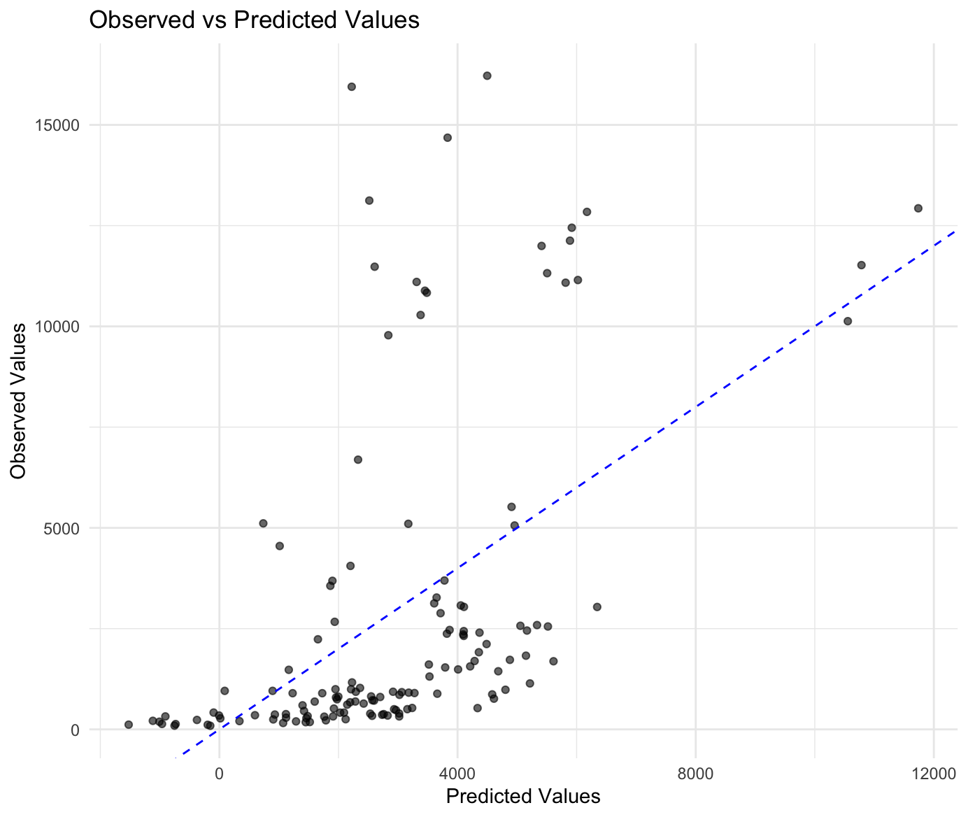
Results – Regression analysis of the IWW model
Dashed blue line represents the ideal fit of the model.
For smaller values
Many points are clustered near zero (both observed and predicted values). This could indicate that the model performs relatively better for smaller values of the dependent variable.
For larger values
For larger predicted values there seems to be more deviation between observed and predicted values.

Slide 10
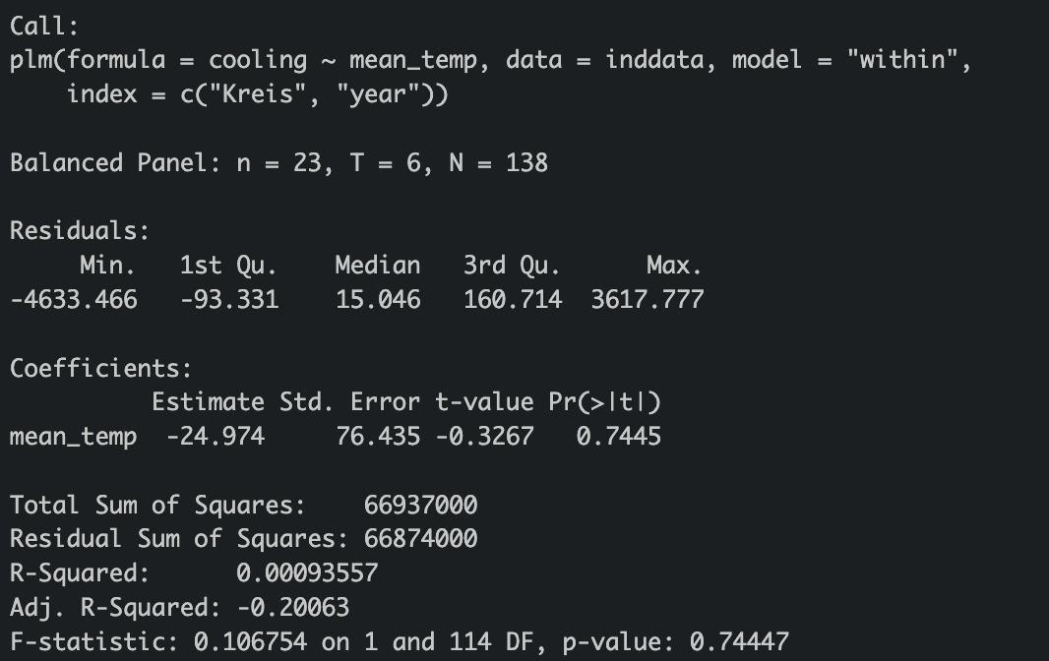
Results – Regression analysis of the cooling water model
Developed a regression function to test the relationship between water used explicitly for cooling and mean temperature
Cooling water ​= β0​+β1​⋅Mean_temp +ϵ
A unit increase in mean_temp is associated with a decrease in cooling by approximately 24.974 units.
The direction of this relationship is negative, suggesting that higher temperatures are not associated with increased cooling in this model, however this result can be neglected as it is not statistically significant.
p-value: 0.7445
The high p-value confirms that the effect of mean_temp on cooling is not statistically significant at confidence interval of 0.05

Slide 11
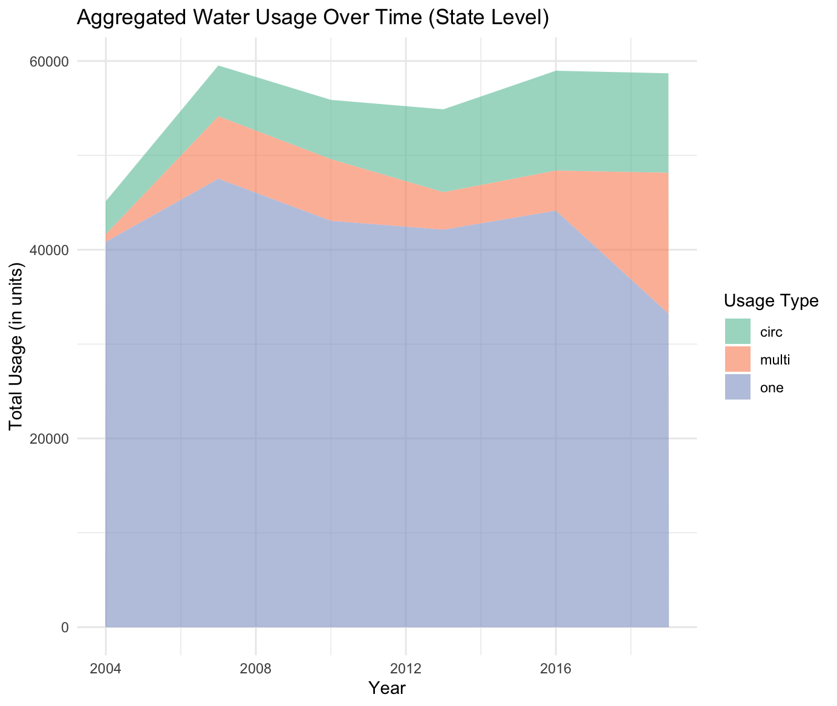
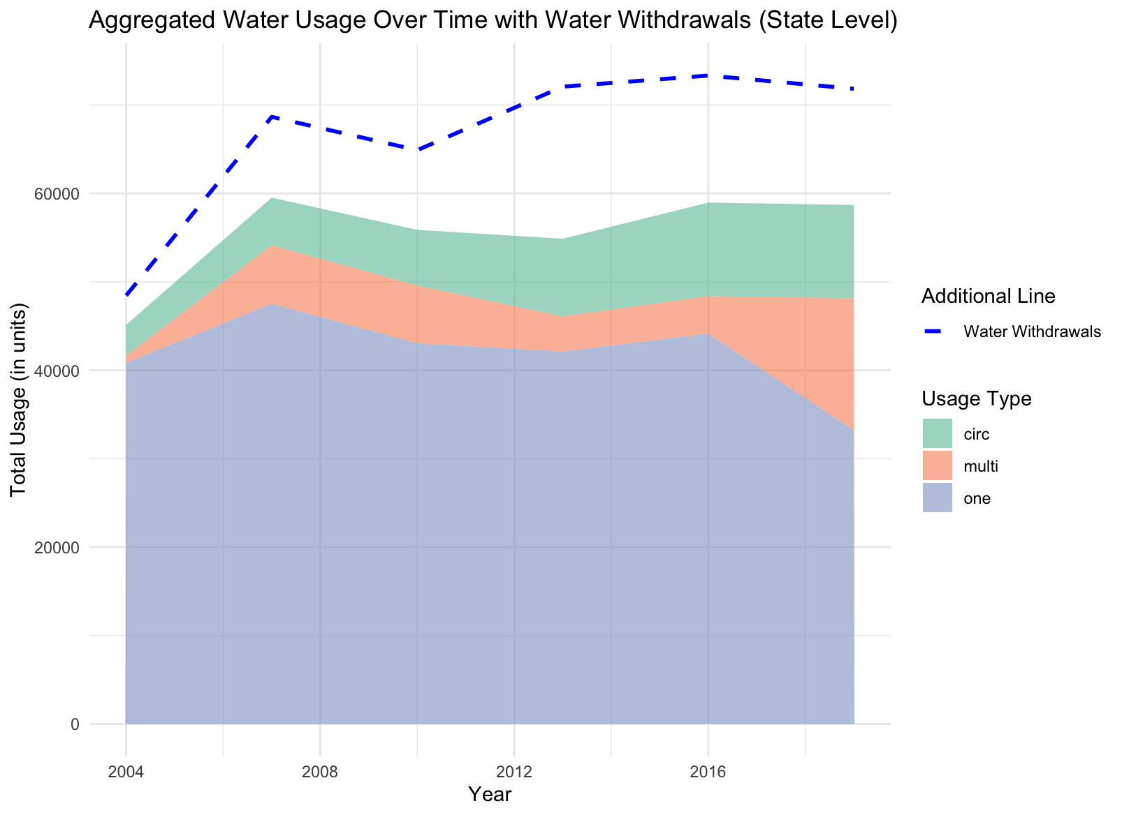
Visualization of water use by no of times utilized – State level

Slide 12
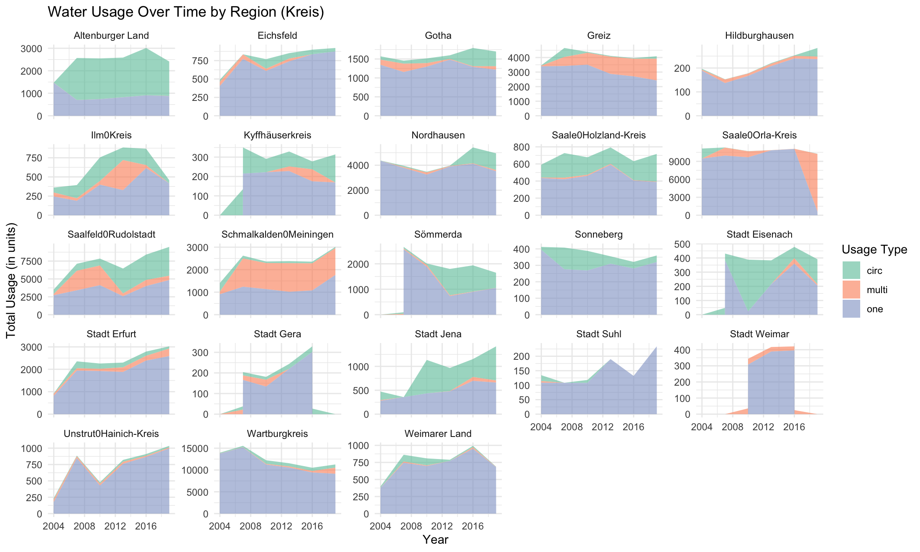
Visualization of water use by no of times utilized – Kreis level
Notes:
Low Circular Kreis: aggregated and 75% or more singular use
Hildburghausen, Stadt Suhl, Stadt Weimar, Unstrut0Hainich-Kreis, Wartburgkreis, Weimarer Land
LOW_C: at each year 75% or more singular use
Altenburger Land, Eichsfeld, Greiz, Hildburghausen, Ilm0Kreis, Nordhausen, Saale0Orla-Kreis, Sömmerda, Sonneberg, Stadt Suhl, Stadt Weimar, Unstrut0Hainich-Kreis, Wartburgkreis, Weimarer Land

Slide 13
New Framework
Gross Value added (GVA) at Kreis Level
Climate Elasticity (CE)
Water Use
Other
Cooling
Single
Multi
Circular
Technological Change (TC)
Water Withdrawals

Slide 14
Prognose industrielle Wassernachfrage
Sammlung historischer Daten über;
Industrielle Wasserentnahmen (IWA): Aus Thüringer Landesamt für Statistik (TLS).
Bruttowertschöpfung (BWS): Repräsentiert die industrielle Wirtschaftstätigkeit.
Klimaextreme (KE): Einschließlich historischer Klimadaten und projizierter Temperatur unter ausgewählten SSP/RCP-Szenarien.
Technologischer Wandel: Verwendung von Daten über branchenspezifische wassersparende Technologien oder Schätzungen auf der Grundlage von technologischen Trends.
Spezifizierung eines multiplen Regressionsmodells zur Bewertung der direkten Auswirkungen von BWS, KE
Simulation unter SSP/RCP-Szenarien, um die zukünftige Binnenschifffahrt zu prognostizieren. Analyse der Ergebnisse für verschiedene klimatische und wirtschaftliche Annahmen.

Slide 15
Data Sources
Thüringer Landesamt für Statistik
Non Public water supply statistics (2001 – 2019)
Gross Value added (2001 – 2019)
SSP Database (Shared Socioeconomic Pathways) - Version 2.0
DWD weather climate extremes
Index of /climate_environment/CDC/regional_averages_DE/annual/
Other related literature sources
Hydrogen Renewable Energy Site
Industry database

